Slide 1
Standards for Innovation Webinar
16th September 2025

Slide 2
Housekeeping
Your cameras will remain turned off and your microphones on mute for the duration of the webinar
To ask any questions please use the Q&A function and we will get to these after the presentations
If questions are for one of the speakers in particular please make sure to reference this in the question
The session will be recorded and made available afterwards
All slides will also be circulated
Running Order
Regulations & Standards Driving thriving Innovation for the UK Chris Carlton, Innovate UK Business Connect
The Standards Process, Emma Glass, British Standards Institute
The Industry Perspective, Brian Bishop President, Open Connectivity Foundation
Q&A

Slide 3
Regulations & Standards Driving thriving Innovation for the UK
Standards for Innovation Webinar, 16th September
Chris Carlton
Knowledge Transfer Manager for Government Innovation

Slide 4

About Us
Innovate UK Business Connect exists to connect innovators with new partners and new opportunities beyond their existing thinking – accelerating ambitious ideas into real-world solutions.

Slide 5

Our Purpose & Vision
We are part of Innovate UK, the UK’s innovation agency.
We create diverse connections to drive positive change.
To establish a network of innovators so powerful its ideas will change the world.

Slide 6
Innovate UK Family

Slide 7
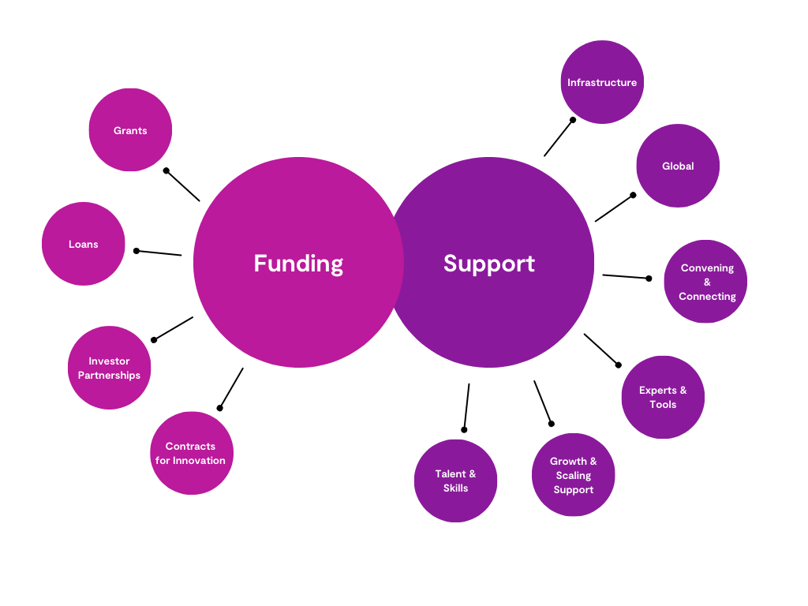











Innovate UK Family

Slide 8
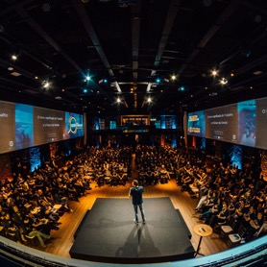



Our Values
Open
Creative
Collaborative
Determined
We value diversity of opinions, ideas, skills and perspectives.
We embrace ideas with curious minds and use our insight to uncover opportunity.
We are one team, working together across sectors, people and geographies to drive positive change.
We are determined to
meet challenges with
solutions and enable
innovators to think and
act beyond expectations.

Slide 9
Our Strategy
Positive Change
Deep Expertise
Powerful Connections
Future Shaping
Our
People
We create diverse connections to drive positive change
We have wide-ranging expertise and convene the expertise of others
We drive powerful connections with business at the heart of what we do
We shape the innovation communities of the future
We provide an exceptional place of work for our exceptional people

Slide 10




Our Network
46,229
Unique Organisations
72%
Small
15%
Medium
13%
Large
335,478
innovators
Every university in the UK

Slide 11

IUK Business Connect Outputs
66%
42%
60%
£100m
introduced by IUK Business Connect go on to collaborate
reach outcomes faster (1-2 years)
increased investment in R&D direct result from IUK Business Connect engagement
per year increased investment in R&D

Slide 12
We connect
Diverse communities | Innovate UK Innovation Networks
Regional, national and global | Innovate UK Global Alliance
Research and business | Innovate UK Knowledge Transfer Partnerships
Innovators, funders & collaborators | Innovate UK Innovation Exchange
…for positive change

Slide 13

Regulations and Standards for Innovation
Innovate UK’s programme of activities

Slide 14

Strategic Theme - Government Levers
UK Government is committed to encouraging innovation and supporting innovating businesses
Levers include procurement, standards, intellectual property regimes, legislation, and regulation
We will help Government to use its power to support innovation, including through managed programmes, public sector procurement and collaboration with NQI bodies and regulators
Regulatory and Standards Environment
Public Sector Needs and Procurement
Intellectual Property Framework
Help shape markets, accelerate business innovation and achieve societal good
Public sector procurement, and business helping Government achieve its priorities
Help companies evaluate, protect and exploit intellectual assets to support growth

Slide 15
Why do Government Levers matter for Innovation?
There are many things government can do to shape markets and help companies develop and take new products, services and processes to market. We are committed to supporting that effort.
Government can use numerous levers to stimulate and support UK business innovation, including legislation, regulation, standards, intellectual property regimes, and public procurement. We work with partners across government and the public sector to help them use these levers as a catalyst for innovation.
The UK should continue to play its important part in the development and adoption of internationally agreed measurements, standards, and new regulation that support business-led innovation. The ability to independently measure the performance of ideas de-risks claims and makes them more attractive to investors.
If we get this right, it will stimulate innovation rather than block implementation, it will reduce investment risk rather than increase it, and it will improve consumer confidence and attract inward investment.

Slide 16
Why Standards are Important to Innovation
Helps companies draw on best practice from those in the industry, particularly early into their lifetime
Will help identify any potential pitfalls earlier in the innovation journey and help future compliance with regulation
Adherence to nationally (and internationally) agreed standards helps provide credibility and confidence to investors and funders
Standards act as kitemarks which can demonstrate responsible innovation to customers. This can help with building trusted relationships and can form important parts of marketing and branding

Slide 17
Innovate UK - Driving Ambitious Innovation for the Nation
Creating an environment to encourage
- great innovation to support UK business need,
- drive critical policy change,
- increase economic return and;
- important societal reform
In-depth sector knowledge and a successful track record of national scale regulatory reform
An Innovate UK ‘Portfolio of Programmes’ that
- can rapidly scale, adapt, respond to cross/multiple HMG Departmental needs
- Build critical national networks to effect change, at scale
A mature, national-scale Blueprint to support Industrial Policy and Mission-based approach

Slide 18
UK Regulatory Science & Innovation Networks Programme
Overview
£7.5m investment (unlocking an extra £6.5 from OLS & MHRA for human health networks) to establish networks of expertise across economic sectors that generate evidence using regulatory science tools to assist policymakers/regulators in addressing issues such as fragmentation and the current lag between regulation and cutting-edge innovation.
How this helps HMG / industry
Data-driven, pro-innovation policymaking: Networks will develop evidence-based recommendations, informed by tools, datasets and analysis using regulatory science. This will enable HMG to make better, more evidence-based policy decisions, which in turn helps innovators and consumers.
Future-proofing regulations: Using methods like predictive modelling to anticipate the risks and benefits of emerging technologies, networks’ outputs will enable more regular updates to regulation / improve its ability to keep pace with innovation.
Collaboration: Networks will provide a focal point for collaboration and consensus-building between HMG, research base, industry and stakeholders in specific sectors, leading to a more unified approach to regulation.
UK Regulatory Science and Innovation Networks – UKRI

Slide 19
Global Regulation Index
Overview
First-of-its-kind tool comparing and ranking countries based on their regulatory systems’ ability to support innovation.
Focuses on four key innovation sectors: Transport, Fintech, Energy, and Telecoms.
Analyses cross-cutting themes related to regulation and innovation.
Provides data and insights on global best practices in stimulating innovation through regulatory frameworks.
The index can be found here
How this helps HMG / industry
Helps policymakers and regulators identify regulatory practices that are most supportive of innovation, and to understand how regulations can be adapted to encourage innovation.
Provides guidance on achieving economic growth through a focus on innovation.
Offers insights on aligning regulations with broader societal and environmental goals.

Slide 20
Other activities
Working with the Regulatory Innovation Office (RIO) to help build an evidence base (from our customers and investments) that underpins smart, agile pro-innovation regulatory policy and practice.
Membership of the DSIT-led Regulators Innovation Network, influencing its programme of activities/work plans.
Delivered first round of the Regulators Pioneer Fund in 2018, and have influenced the design of Rounds 2 and 3 (run in-house by DSIT).
Engaging with the Digital Regulation Cooperation Forum (DRCF) to help with evidence generation for their AI and Digital Advice Hub
Collaboration with the British Standards Institute (BSI) to arrange an Innovation Management Summit on 9th October (more on this later)

Slide 21

Innovate UK Business Growth
The indispensable partner for ambitious innovators
We equip innovation-focused businesses to make the best strategic choices and harness the right resources to accelerate their growth.
Over 6,000 innovators benefit from our intensive and tailored advisory support to achieve their ambitious goals every year.
We are in their corner – do you want us in yours? Visit iukbg.ukri.org to learn more.
97% of clients would recommend us
“Innovate UK Business Growth gave us the tools to grow with confidence”
Natali Georgieva, Co-founder at ALIANAz
94% report that our service has had a positive impact on their growth

Slide 22
IUK Business Growth- Who do we support?
Ambitious, innovation-focused businesses that are growing strongly, or that have high growth potential ​
Registered at Companies House with up to 250 employees​
Management teams motivated to engage fully with us to help achieve growth milestones​
Businesses with or without Innovate UK grants

Slide 23



Innovate UK Business Growth- Our service
Innovate UK provides high-quality strategic advisory support as a partner to its clients. The Innovate UK Business Growth service uniquely combines:
A comprehensive spectrum of innovation and commercial expertise
A single access point
to the most significant regional, national and international innovation resources
1:1 support that is flexible and tailored in focus and timescale to the individual needs of innovative businesses

Slide 24


Innovate UK Business Growth- standards resources
IUK Business Growth clients (apply here iukbg.ukri.org ) gain tailored standards support through the Standards Business Growth Toolkit (BGT).
BGT includes access to the BSOL (>100,000 standards), training on key standards and HOW TO guides.
Standards resources available for all:
The Standards Show podcasts on You Tube
Case Study- Eventum Orthopaedics gaining ISO 13485 certification (quality & safety of medical devices) – leading to achieving UKCA mark, USA 510(k) clearance- launch of new product in these markets
Notes:
This is what we want you to remember

Slide 25
Ambitions

Slide 26
Standards Challenge Fund
Overview
A £1 million initiative funded by IUK & delivered by BSI, to develop standards in emerging, high-growth potential sectors where the UK stands to benefit.
To encourage participation in standardisation from innovative SMEs and companies.
Focuses on companies not previously involved in standardisation activities.
Four new standards are in development across three key domains: Net Zero, Healthy Living & Agriculture and Digital Technologies, with a fourth being cross-sectoral.
Offers options for full standards, Publicly Available Specifications (PAS), or BSI Flex standards.
Potential for programme expansion based on initial success.
Benefits
SMEs gain opportunity to influence the development of standards in their fields, shape new markets and create commercial opportunities.
Wider participation in standardisation ensures a broader range of voices are heard in development of standards.
Helps anchor emerging technologies in the UK through a framework of agreed-upon specifications and guidelines that promote safety, interoperability and quality.

Slide 27
Other Ambitions
Future rounds of the Regulators Pioneers Fund (RPF)
Influence the design of future round of the RPF, incl. scope, aims & objectives, alignment with IUK priorities.
Updates to GRI
Commission updates / new versions of the GRI to cover new sectors, or to undertake new research into regulation and its impact on innovation.
Developing evidence base for new Regulatory Innovation Office
Embedding existing IUK products (UK RSINs, GRI etc) within RIO ways of working.
Commissioning research/developing new evidence products on its behalf.
Regulatory Innovation Summit
Summit to celebrate completion of RSINs and discuss evidence findings and best practice
Open to all
Expected in March 2026

Slide 28
Connecting
Overview
Focussing on Innovate UK Business Connect’s purposes of connecting and convening we are keen to explore future opportunities to add value in this space.
If you are aware of any areas which would benefit from getting parties together to talk about best practice or blockers in the standards (or regulation) area, we are keen to hear from you
Equally we are keen to explore nascent areas where there are opportunities to bring together communities to discuss the shape of new standards submissions.
We have a fantastic events team and will be happy to do all the work in bringing the parties together. We’ll even write a public report of the findings of our discussions afterwards which will form a fantastic first step in making a submission into the standards system
Please Get In Touch!

Slide 29
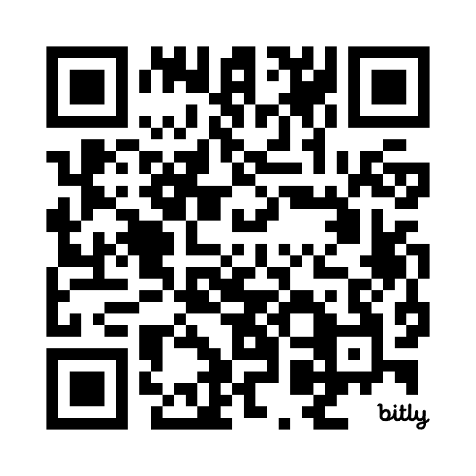
Find out more
Chris Carlton
Knowledge Transfer Manager for Government Innovation
Chris.Carlton@iukbc.org.uk

